Slide 1
S-Store
The Fastest OLTP Database in the World
Notes:
My name is Vojin and I will present

Slide 2
Online Transaction Processing Market
Bread and Butter of the Enterprise
Based on database expert testimonials
For 80% performance is most important
15% using 32% plan to use an in-memory database
Market is over 10 billion dollars
Growing by 15-20% every year

Slide 3
Need for Speed
Bread and Butter of the Enterprise
Based on database expert testimonials
For 80% performance is most important
15% using 32% plan to use an in-memory database
Market is over 10 billion dollars
Growing by 15-20% every year

Slide 4


Performance
Transaction Processing
View Maintenance
Logarithmic Scale

Slide 5
Quad-chart

Slide 6
How?
Build a Database in Memory with run-time code generation
Include an optimizing compiler
Include the K3 calculus
Automatic partitioning
High-level programming interface for diversity of data

Slide 7
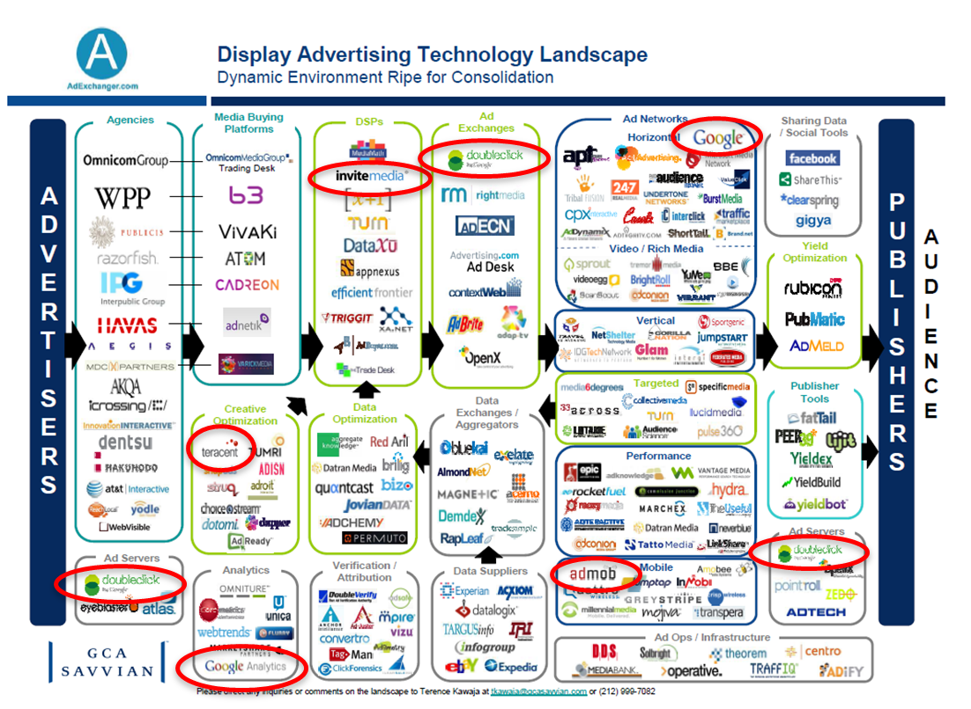


Time is Money
Today, every microsecond counts

Slide 8
Time is Money
Recommendations based on real-time data
Smarter algorithms that maximize the added value
Better trading decisions

Slide 9

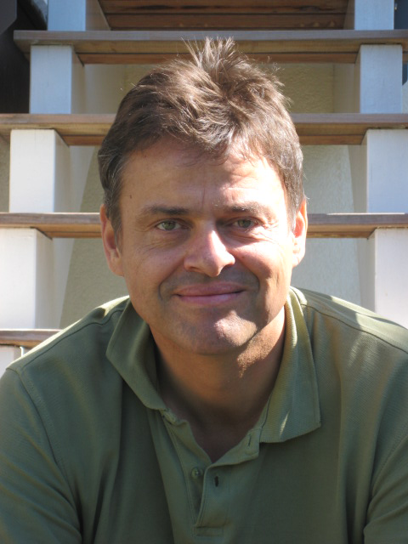
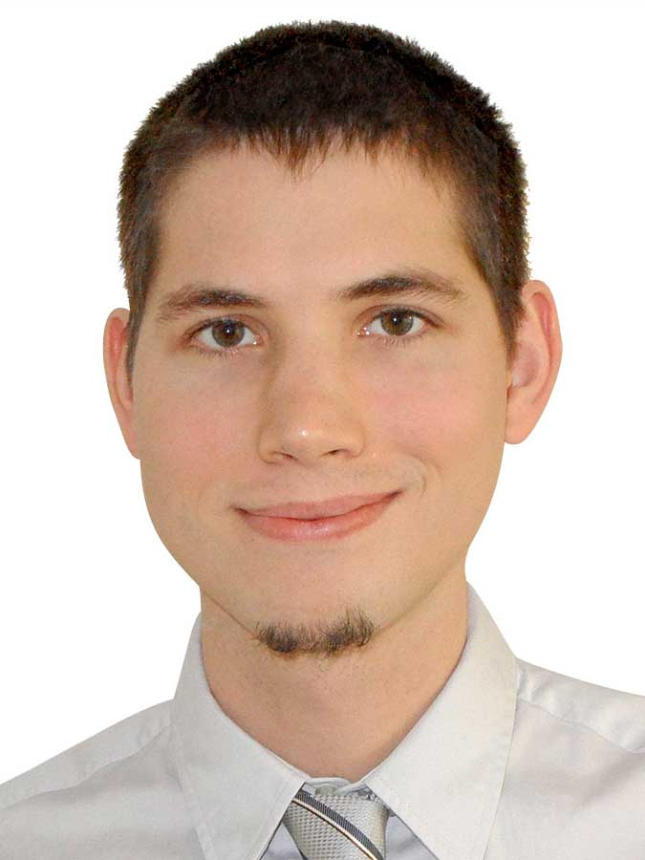
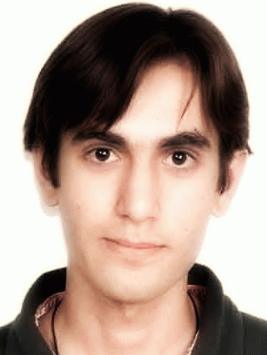

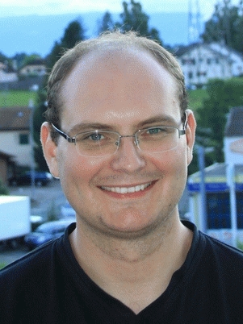
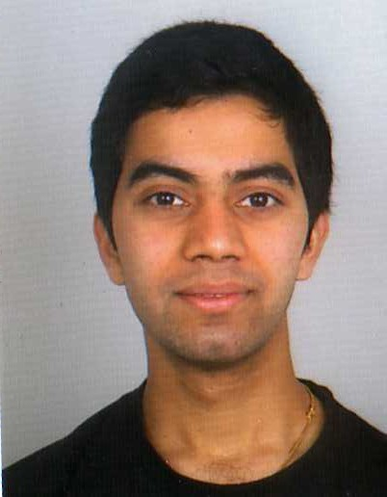
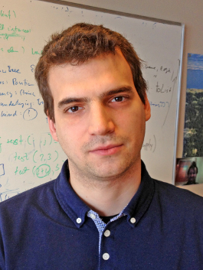

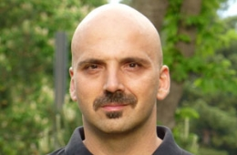
The DB Team
The Compiler Team
The Muscle

Slide 10
S-Store
The Fastest OLTP Database in the World

